Slide 1
Service RDC Rollout
Limited Launch
Friday April 26th 2013

Slide 2
Agenda
SVC RDC Launch Review
Program Schedule Update
Issues Log
DC Shipments [QA] (Eric Blue)
SVC RDC Orders Review
E-mail Resources…
Q&A

Slide 3
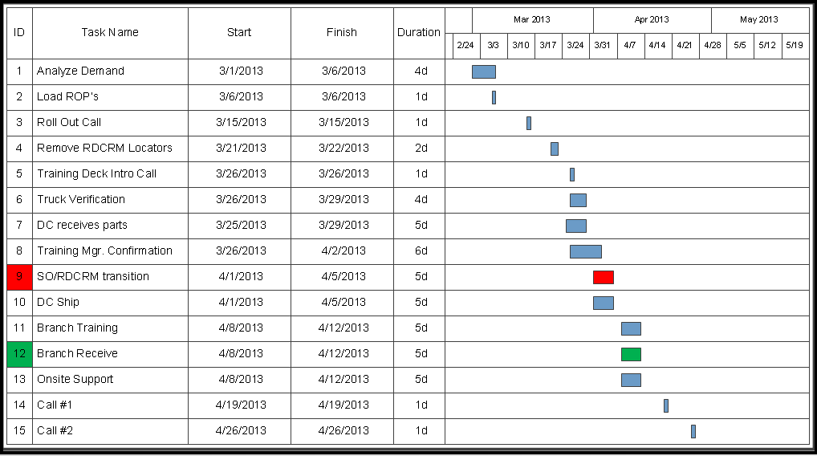

Service RDC Program Schedule
Completed

Slide 4
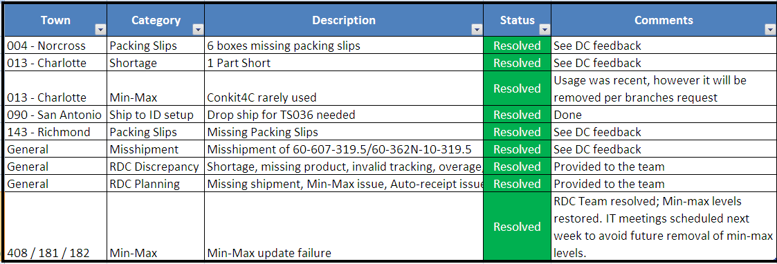
Issues Log

Slide 5
ADT Residential Quality Issues
Largest Pain Points:
Shortages
Missing Packing Slips
Research Steps
Analyzed the data from the field and customer service
Sorted for common cause parts
Location audit was performed
No clear issue was found to drive errors
Sorted for common cause pickers
Identified source of most errors
One picker was tied to 12% of the orders
One picker was tied to 7% of the errors
Conducted end of line audits
Found four errors in seven branches
Conducted inline audits
Found one missing packing list in two branches
Determined Root Cause:
The data leads us to believe that in support of the increased demands for ADT Resi and TIS we added labor without the normal time we’d take to fully train and evaluate the new associates.
Corrective Actions
Adding a full time auditor to HVRDC – Implemented 4/23
Added IC associate to HVRDC area to address location accuracy and part issues to help keep the picker focused on picking – Implemented 4/24
Coaching and counseling as appropriate – On going
Supervisor and leadership audits during the day – Implemented 4/24

Slide 6
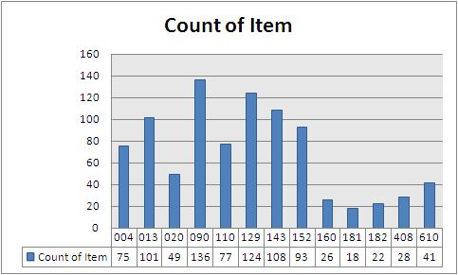
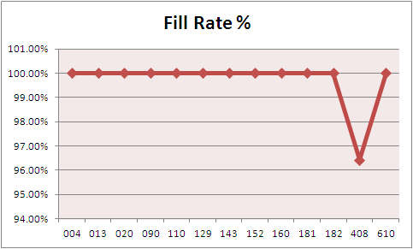
SVC Orders Last Week
Last Weeks lines by Branch
Last Weeks Order FillRate by Branch
99.89%

Slide 7
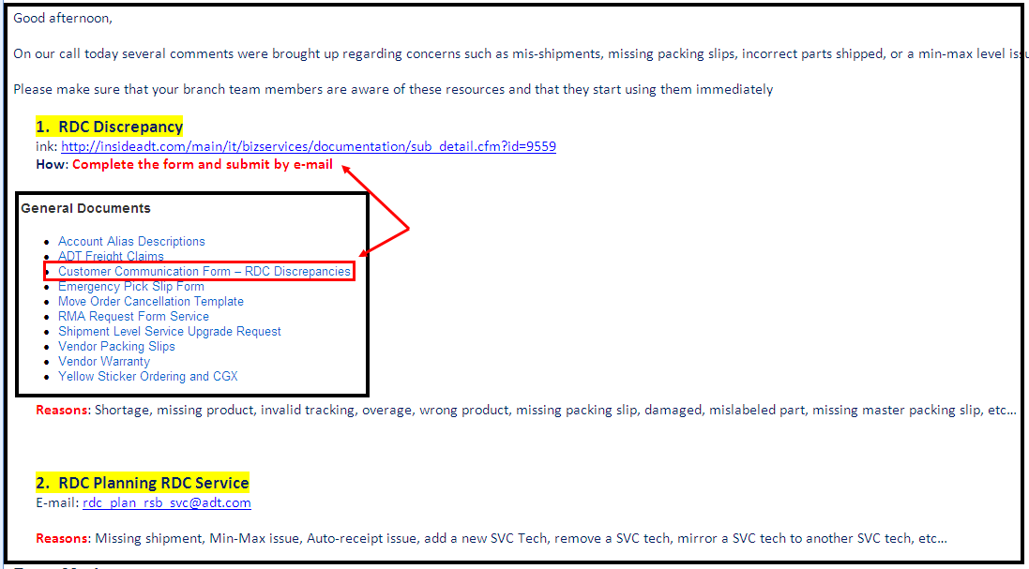
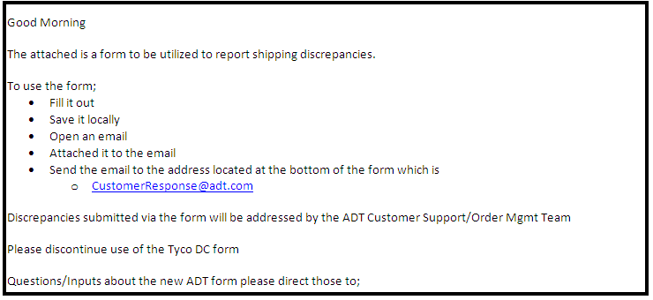
E-mail Resources…
1
2

Slide 8

Questions

